Slide 1
Metodi Numerici per la Bioinformatica
Cluster Analysis
A.A. 2008/2009
Francesco Archetti

Slide 2
Overview
What is Cluster Analysis?
Why Cluster Analysis?
Cluster Analysis
Distance Metrics
Clustering Algorithms
Cluster Validity Analysis
Difficulties and drawbacks
Conclusions

Slide 3
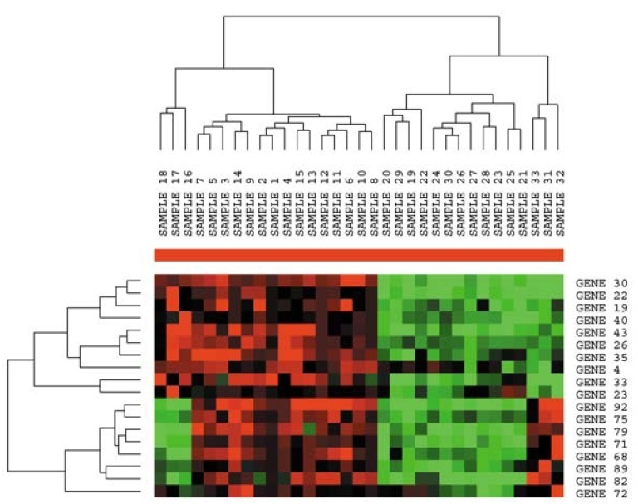
What is clustering?
Clustering: the act of grouping “similar” object into sets
In general a clustering problem consists in finding the optimal partitioning of the data into J clusters (exclusive)

Slide 4
Biological Motivation
DNA Chips/Microarrays
Measure the expression level of a large number of genes within a number of different experimental conditions/samples.
The samples may correspond to
Different time points
Different environmental conditions
Different organs
Cancerous or healthy tissues
Different individuals

Slide 5
Biological Motivation
Microarray data (gene expression data)is arranged in a data matrix where
Each gene corresponds to a row
Each condition corresponds to a column
Each element in a gene expression matrix
Represents the expression level of a gene under a specific condition.
Is usually a real number representing the logarithm of the relative abundance of mRNA of the gene under the specific condition.

Slide 6
What is clustering?
A clustering problem can be viewed as unsupervised classification.
Clustering is appropriate when there is no a priori knowledge about the data.
Clustering is a common analysis methodology able to
verify intuitive hypothesis related to large data distribution
perform a pre-processing step for subsequent data analysis (ex.: identification of predictive genes for tumor classification purpose)
Identification of BIOMARKERS
Absence of class labels
 |  | Exp.
 |  | e1 | e2 | e3 | e4 | L
Genes | g1 | 0.76 | 3.2 | … | - 0.45 | ?
 | g2 | … | … | … | … | ?
 | g3 | … | … | … | … | ?
 | g4 | … | … | … | … | ?
 | g5 | … | … | … | … | ?
 |  | Genes
 |  | g1 | g2 | g3 | g4 | g5 | L
Exp. | e1 | 0.76 | … | … | … | … | ?
 | e2 | 3.2 | … | … | … | … | ?
 | e3 | … | … | … | … | … | ?
 | e4 | - 0.45 | … | … | … | … | ?
Notes:
In generale si utilizza la cluster detection quando
si sospetta che nei dati da analizzare esistano raggruppamenti naturali rappresentativi di classi (per esempio clienti o prodotti con molte caratteristiche comuni)
Si vuole ridurre la complessità dell’analisi ed aumentare così le probabilità di successo di una tecnica di data mining, nel caso in cui la coesistenza di diversi pattern nell’insieme dei dati renda altrimenti difficile l’identificazione di un singolo schema.

Slide 7










What is clustering?
Clustering is subjective
Simpson's Family
School Employees
Females
Males
This label is unknown!
Clustering depends on a similarity ( relational criterion )
that will be expressed thru a distance function
Notes:
Continuo ad avere qualche dubbio. Mentre M & F potrebbero essere 2 cluster che si dividono una popolazione , lo stesso non mi sembra si possa dire tra simpson e employees : potrebbe essere le diverse famiglie o le diverse attività lavorative.

Slide 8
What is clustering?
Clustering can be done on any data:
genes, sample, time points in a time series, etc.
The algorithm will treat all inputs as a set of n numbers or an n-dimensional vector.

Slide 9
Why Cluster Analysis?
Clustering is a process by which you can explore your data in an efficient manner.
Visualization of data can help you review the data quality.
Assumption: “Guilt by association” – similar gene expression patterns may indicate a biological relationship.

Slide 10
Why Cluster Analysis?
In transcriptomics, clustering is used to build groups of genes with related expression patterns in different experiments (co-expressed genes).
Often the genes in such groups code for functionally related proteins, such as enzymes for a specific pathway, or are co-regulated. ( undestanding when co-expression means co-regulation is a very difficult task, still necessary for inferring the regulatory network and hence a “druggable network “ ).
In sequence analysis, clustering is used to group homologous sequences into gene families.

Slide 11
Why Cluster Analysis?
In high-throughput genotyping platforms clustering algorithms are used to associate phenotypes.
In cancer diagnosys and treatments:
Identify new classes of biological samples (e.g. tumor subtypes)
The Lymphoma diagnosys example
Individual Treatments
The same cancer type (over different patients) does not imply the same drug response
NCI60 ( the expression levels of about 1400 genes and the pharmacoresistance with respect to 1400 drugs provided by National Cancer Institute for 60 tumour cell lines )

Slide 12
Expression Vectors
Gene Expression Vectors encapsulate the expression of a gene over a set of experimental conditions or sample types.
Numeric Vector
-0.8
1.5
1.8
0.5
-0.4
-1.3
0.8
1.5
Line Graph
Heatmap
-2
2

Slide 13
Expression Vectors as Points in ‘Expression Space’
t 1
t 2
t 3
G1
-0.8
-0.3
-0.7
G2
-0.4
-0.8
-0.7
G3
-0.6
-0.8
-0.4
Similar Expression
G4
0.9
1.2
1.3
G5
1.3
0.9
-0.6
Experiment 3
Experiment 2
Experiment 1

Slide 14
Intra-cluster and Inter-cluster distances
Inter-cluster distances are maximized
Intra-cluster distances are minimized

Slide 15
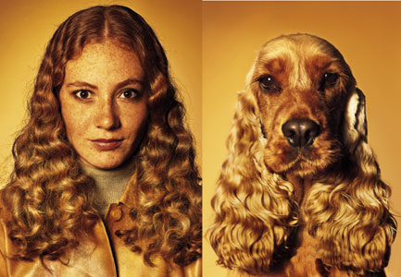
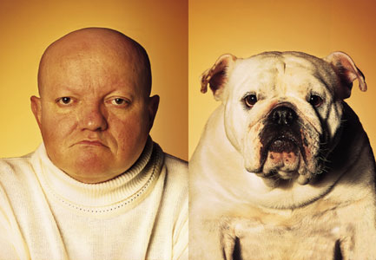
What is similarity?
Similarity is hard to define, but…
“We know it when we see it”
Detecting similarity is a typical task in machine learning

Slide 16
Cluster Analysis
When trying to group together objects that are similar, we need:
Distance Metric – which define the meaning of similarity/dissimilarity
a) Two conditions and n genes b) Two genes and n conditions

Slide 17
Cluster Analysis
Clustering Algorithm:
which define the operations to obtain a set of clusters
Considering all possible clustering solutions, and picking the one that has best inter and intra cluster distance properties is too hard…
g1
g2
g3
g4
g5
Possible clustering solution!!!
Where k is the number of clusters and n the number of points

Slide 18
Distance Metric properties
A distance metric d is a function that takes as arguments two points x and y in an n-dimensional space R^{n} and has the following properties:
Symmetry : The distance should be simmetric, i.e:
d(x,y)=d(y,x)
This mean that the distance from x to y should be the same as the distance from y to x.
Positivity : The distance between any two points should be a real number greater than or equal to zero:
d(x,y)≥0
for any x and y. The equality is true if and only if x = y, i.e. d(x,x)=0.
Triangle inequality : The distance between two points x and y should be shorter than or equal to the sum of the distances from x to a third point z and from z to y:
d(x,y)≤ d(x,z)+ d(z,y)
This property reflects the fact that the distance between two points should be measured along the shortest route.
Many different distances can be defined that share the three properties above!

Slide 19
Distance Metrics
Exp 1
Exp 2
Exp 3
Exp 4
Exp 5
Exp n
Gene_A (X)
x₁
x₂
x₃
x₄
x₅
x_{n}
Given two n-dimensional vectors x=(x₁, x₂,…,x_{n}) and y=(y₁, y₂,…,y_{n}) , the distance between x and y can be computed according to:
Gene_B (Y)
y₁
y₂
y₃
y₄
y₅
y_{n}
Euclidean distance
squared
standardized
Manhattan distance
Chebychev distance
Cosine similarity (Angle)
Correlation distance
Mahalanobis distance
Minkowski distance

Slide 20
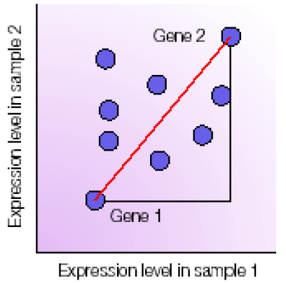
Distance Metric: Euclidean Distance
The Euclidean Distance takes into account both the direction and the magnitude of the vectors
The Euclidean Distance between two n-dimensional vectors x=(x_{1,}x_{2,}…,x_{n}) and y=(y_{1,}y_{2,}…,y_{n}) is:
Each axis represents an experimental sample
The co-ordinate on each axis is the measure of
expression level of a gene in this sample.
several genes in two experiments
(n=2 in the above formula)
Notes:
ogni gene è trattato come un punto nello spazio multidimensionale
ogni asse è un campione biologico separato
la coordinata su ogni asse è la misura di espressione genica in quel campione
La distanza Euclidea si basa sul teorema di pitagora!

Slide 21
Distance Metric: Squared Euclidean Distance
The squared Euclidean distance between two n-dimensional vectors x=(x₁,x₂,…,x_{n}) and y=(y₁,y₂,…,y_{n}) is:
When compared to Euclidean distance the squared Euclidean Distance tends to give more weights to the outliers (genes with very different expression levels in any conditions or two conditions wich exibit very different expression levels in any genes) due to the lack of the square root.

Slide 22
Distance Metric: Standardized Euclidean Distance
The idea behind the standardized Euclidean is that not all directions are necessarily the same.
The standardized Euclidean distance between two n-dimensional vectors x=(x₁,x₂,…,x_{n}) and y=(y₁,y₂,…,y_{n}) is:
Uses the idea of weighting each dimension by a quantity inversely proportional to the amount of variability along that dimension.
Where s²₁ is the sample variance over the 1° dimension in the input space.
 |  | Exp.
 |  | e₁ | e₂ | e₃ | e_{n}
Genes | x | x₁ | x₂ | … | x_{n}
 | y | y₁ | y₂ | … | y_{n}
 | … | … | … | … | …
 | … | … | … | … | …
 | … | … | … | … | …

Slide 23
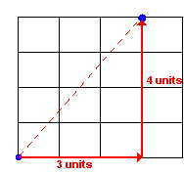
Distance Metric: Manhattan Distance
Manhattan distance represents distance that is measured along directions that are parallel to the x and y axes
Manhattan distance between two n-dimensional vectors x=(x_{1,}x_{2,}…,x_{n}) and y=(y_{1,}y_{2,}…,y_{n}) is:
Manhattan distance represents distance that is measured along directions that are parallel to the x and y axes
Manhattan distance between two n-dimensional vectors x=(x_{1,}x_{2,}…,x_{n}) and y=(y_{1,}y_{2,}…,y_{n}) is:
Where represents the absolute value of the difference betweeen x_{i} and y_{i}

Slide 24
Distance Metric: Chebychev Distance
Chebychev distance simply picks the largest difference between any two corresponding coordinates. For instances, if the vector x=(x_{1,}x_{2,}…,x_{n}) and y=(y_{1,}y_{2,}…,y_{n}) are two genes measured in n experiments each, the Chebychev distance will pick the one experiment in which these two genes are most different and will consider that value the distance between genes.
Is to be used when the goal is to reflect any big difference between any corresponding coordinates
Chebychev distance between two n-dimensional vectors x=(x_{1,}x_{2,}…,x_{n}) and y=(y_{1,}y_{2,}…,y_{n}) is:
Note that this distance measurement is very sensitive to outlying measurements and recilient of small umount of noise.

Slide 25
Distance Metric: Cosine Similarity (Angle)
The Cosine Similarity takes into account only the angle and discards the magnitude.
The Cosine Similarity distance between two n-dimensional vectors x=(x₁,x₂,…,x_{n}) and y=(y₁,y₂,…,y_{n}) is:
Gene1 Expression Level
Gene2 Expression Level
where is the dot product of the two vectors:
and is the norm, or length, of a vector:

Slide 26
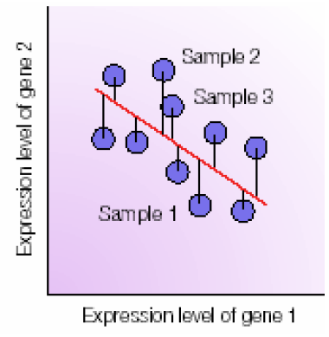
Distance Metric: Correlation Distance
The Pearson Correlation Distance computes the distance of each point from the linear regression line
The Pearson Correlation distance between two n-dimensional vectors x=(x₁,x₂,…,x_{n}) and y=(y₁,y₂,…,y_{n}) is:
where r_{x,y} is the Pearson Correlation Coefficient of the vectors x and y:
Note that since the Pearson Correlation Coefficient r_{xy}
Varies only between 1 and -1, the distance 1- r_{xy} will take values between 0 and 2!

Slide 27
Distance Metric: Mahalanobis distance
Manhattan distance between two n-dimensional vectors x=(x_{1,}x_{2,}…,x_{n}) and y=(y_{1,}y_{2,}…,y_{n}) is:
where S is any n x m positive definite matrix and (x-y)^{T}is the trasposition of (x-y).
The role of the matrix S is to distort the space as desidered. Usually this matrix is the covariance matrix of the data set
If the space warping matrix S is taken to be the identity matrix, the Mahalanobis distance reduces to the classical Euclidean distance :

Slide 28
Distance Metric: Minkowski Distance
Minkowski distance is a generalization of Euclidean and Manhattan distance.
Minkowski distance between two n-dimensional vectors x=(x_{1,}x_{2,}…,x_{n}) and y=(y_{1,}y_{2,}…,y_{n}) is:
Recalling that , we note that for m=1 this distance reduces to Manhattan distance, i.e. a simple sum of absolute differences. For m=2 the Minkowski distance reduces to Euclidean distance.

Slide 29
When to use what distance
The choice of distance measure should be based on the particular application :
What sort of similarities would you like to detect?
Euclidean distance – takes into account the magnitude of the differences of the expression levels
Distance Correlation - insensitive to the amplitude of expression, takes into account the trends of the change.

Slide 30
When to use what distance
Sometimes different types of variables need to be mixed together. In order to do this, any of the distances above can be modified by applying a weighting scheme which reflects the “variance “ i.e. the range of variation of the variables or their perceived relative relevance :
i.e. mixing clinical data with gene expression values can be done by assigning different weights to each type of variable in a way that is compatible with the purpose of the study
In many case it is necessary to normalize and/or standardize genes or arrays in order to compare the amount of variation of two different genes or arrays from their respective central locations.

Slide 31
When to use what distance
Standardizing gene values can be done by applying a z-transform (i.e substracting the mean and dividing by the standard deviation).
For a gene g and an array i, standardizing the gene means adjusting the values as follows:
where is the mean of the gene g over all arrays and s_{g.} is the standard error of the gene g over the same set of measurements. The values thus modified will have a mean of zero and a variance of one across the arrays.
Standardizing array values means adjusting the values as follows:
where is the mean of the array and s_{.i} is the standard error of the array across all genes.

Slide 32
When to use what distance
Genes standardization makes all genes similar N(0,1) A gene that is affected only by the inherent measurements noise will be indistinguishable from a gene that varies 10 fold from one experiment to another. Although there are situations in which this is useful, gene standardization may not necessarily be a wise thing to do every time
Array standardization is applicable in a larger set of circumstances and is rather simplistic if used as the only normalization procedure.

Slide 33
A comparison of various distances
Euclidean distance: the usual distance as we know it from our environment.
Squared euclidean distance: tends to emphasize the distances. Same data clustered with squared Euclidean might appear more sparse and less compact.
Standardized euclidean: eliminates the influence of different range of variation. All directions will be equally important. If genes are standardized, genes with small range of variation (e.g. affected only by noise) will appear the same as genes with a large range of variation (e.g. changing several orders of magnitude)
Manhattan distance: the set of genes or experiments being equally distant from a reference does not match the similar set constructed with Euclidean distance.

Slide 34
A comparison of various distances
Cosine distance (angle): takes into consideration only the angle, not the magnitude. For instance:
a gene g₁ measured in two experiments : g₁=(1,1)
a gene g₂ measured in two experiments: g₂ =(100,100)
will have the distance(angle):
the angle between these two vectors is zero.
Clustering with this distance measure will place these genes in the same cluster although their absolute expression levels are very different!

Slide 35
A comparison of various distances
Correlation distance: will look to similar variation as opposed to similar numerical values.
Example: If we consider a set of 5 experiments and
a gene g₁ that has an expression of g₁=(1,2,3,4,5) in the 5 experiments.
a gene g2 that has an expression of g2=(100,200,300,400,500) in the 5 experiments.
a gene g3 that has an expression of and g3=(5,4,3,2,1) in the 5 experiments.
The correlation distance will place g₁ in the same cluster of g₂ and in a different cluster of g₃ because:
g₁= (1,2,3,4,5) and g₂=((100,200,300,400,500) have a high correlation d(g₁ ,g₂))=1-r =1-1=0
g₁= (1,2,3,4,5) and g₃= (5,4,3,2,1) are anti-correlated d(g₁ ,g₃))=1-r =1-(-1)=2

Slide 36
A comparison of various distances
Chebychev : focuses on the most important differences: (1,2,3,4) and (2,3,4,5) have distance 2 in Euclidean and 1 in Chebychev. (1,2,3,4) and (1,2,3,6) have distance in Euclidean and 2 in Chebychev.
Mahalanobis: can warp the space in any convenient way. Usually, the space is warped using the correlation matrix of the data.

Slide 37
General observations
Anything can be clustered
Clustering is highly dependent on the distance metric used: changing the distance metric may affect dramatically the number and membership of the clusters as well as the relationship between them.
The same clustering algorithm applied to the same data may produce different results: many clustering algorithms have an intrinsically non-deterministic component.
The position of the patterns within the clusters does not reflect their relationship in the input space.
A set of clusters including all genes or experiments considered form a clustering, cluster tree or dendogram.

Slide 38
Clustering Algorithms
The traditional algorithms for clustering can be divided in 3 main categories:
Partitional Clustering
Hierarchical Clustering
Model-based Clustering

Slide 39
Partitional Clustering
Partitional clustering aims to directly obtain a single partition of the collection of objects into clusters.
Many of these methods are based on the iterative optimization of a criterion ( a.k.a. objective function ) reflecting the “agreement” between the data and the partition.

Slide 40
Objective function optimization problem
Let x be defined as a vector in R^{n}
Given the elements with i=1:I and a set of clusters C_{j} with j=1:J, the clustering problem consists in assigning each element x_{i} to a cluster C_{j} such that the intra-cluster distance is minimized and the inter-cluster distance is maximized.
If we define a matrix Z of dimension IxJ as:
the problem can be formulated, in general terms, as:
Each point belongs to 1 cluster:
No point can be in 2 clusters : z_{ij} *z_{il} =0 for each i=1:I and j=1:J
Several heuristics has been proposed to solve this problem, for example the K-Means algorithm.

Slide 41
Partitional Clustering: k-Means
Set K as the desired number of clusters
Select randomly K representative elements, called centroids
Compute the distance of each pattern( point) from all centroids
Assign all data points to the centroid with the minimum distance
Update the centroids as the mean of the element belonging to each cluster and compute a new cluster membership
Check the Convergence Condition
If all data points are assigned to the same cluster with respect to the previous iteration, and therefore all the centroids remain the same, then Stop the Process
Otherwise reapply the assignment process starting from step 3.

Slide 42
K-means clustering (k=3)
Notes:
Di difficile interpretazione ; uno dei centroidi , tirati a caso, coincide con uno dei punti?

Slide 43
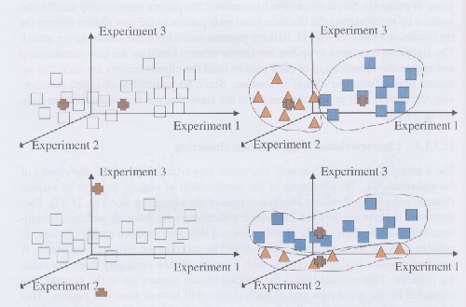
Characteristics of K-means
A different initialization might produce a different clustering
Different runs of the alg. could produce different memberships of the input pattern
The algorithm itself has a low semantic value : the labeling and bio-interpretation of clusters is a subsequent phase.
Initialization
one
Initialization
two

Slide 44
Nearest Neighbor Clustering
k is no longer fixed a priori
Threshold, t, used to determine if items are added to existing clusters or a new cluster is created.
Items are iteratively merged into the existing clusters that are closest.
Incremental

Slide 45
Nearest Neighbor Clustering
Set the threshold t
10
9
8
t
7
6
5
4
3
1
2
1
2
1
2
3
4
5
6
7
8
9
10

Slide 46
Nearest Neighbor Clustering
New data point arrives…
10
9
Check the threshold t
8
7
It is within the threshold for cluster 1, so add it to the cluster, and update cluster center.
6
5
4
3
1
3
2
1
2
1
2
3
4
5
6
7
8
9
10

Slide 47
Nearest Neighbor Clustering
New data point arrives…
10
Check the threshold t
9
4
8
It is not within the threshold for cluster 1, so create a new cluster, and so on..
7
6
5
It’s difficult to determine t in advance!
Different values of t implies different values of intra/inter clusters similarity!
4
3
1
3
2
1
2
1
2
3
4
5
6
7
8
9
10

Slide 48
Hierarchical Clustering
Hierarchical clustering aims at the more ambitious task of obtaining hierarchy of clusters, called dendrogram, that shows how the clusters are related to each other.
50
60
The height of a node in the dendrogram represents the similarity of the two children clusters.
70
80
90
100
% of similarity

Slide 49
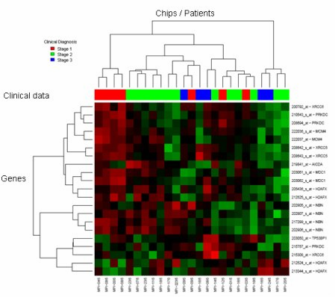
Hierarchical Clustering Result: Dendrogram
Similarity threshold : 60%
Similarity threshold : 70%
Notes:
Di difficile interpretazione :, prima clusterizzo e poi faccio il disegnino; cosa sono gli stage, come giocano le soglie ??

Slide 50
Hierarchical Clustering
Since we cannot test all possible trees we will have to heuristically search all possible trees.
Hierarchical clustering is deterministic
Bottom-Up (agglomerative): Starting with each item in its own cluster, find the best pair to merge into a new cluster. Repeat until all clusters are fused together.
Top-Down (divisive): Starting with all the data in a single cluster, consider every possible way to divide the cluster into two. Choose the best division and recursively operate on both sides.

Slide 51
Agglomerative Hierarchical Clustering
Calculate the distance between all data points (genes or experiments)
Cluster the data points to the initial clusters
Calculate the distance metrics between all clusters
Repeatedly cluster most similar clusters into a higher level cluster
Repeat steps 3 and 4 for the most high-level clusters.

Slide 52
Agglomerative hierarchical clustering
3
4
1
2
5

Slide 53
AHC variants
Various ways of calculating cluster similarity
complete-link
-max dist.-
O(n³)
single-link
-min dist.-
O(n³)
Group-average
-avg dist.-
O(n²)

Slide 54
Agglomerative clustering
the agglomerative (bottom up) hierarchical clustering depends on the choice of the Similarity (distance function ) between clusters .
Single linkage : distance between the closest neighbors
Complete linkage : distance between the furthest neighbors
Central linkage : distance of centers ( centroids)
Average linkage : average distance of all patterns in each cluster
i) and ii) use distances already computed while iv) is the most computationally demanding
Before applying it one should try to prune as much as possible the set of genes of interest ( feature selection ) e.g. by genetic programming

Slide 55
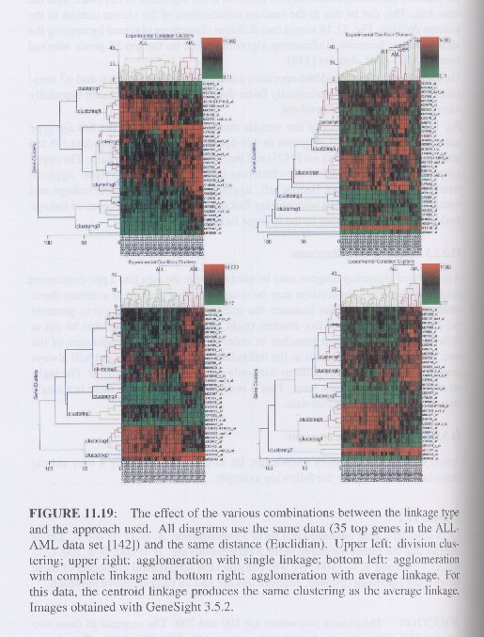
Agglomeration with SINGLE
linkage
Division
Clustering
Agglomeration with COMPLETE
linkage
Agglomeration with
AVERAGE
linkage

Slide 56
Divisive Hierarchical Clustering
All the objects (genes or experiments) are considered to be in one super-cluster.
Divide each cluster into 2 sub-clusters by using k-means algorithm.
Repeat step 2 until all clusters contain a single object (gene or experiment).

Slide 57
Divisive Hierarchical Clustering
X₈
X₁
X₃
X₇
X₆
X₄
X₅
X₂
X₁
X₃
X₅
X₄
X₇
X₂
X₈
X₆
X₁
X₂
X₃
X₇
X₈
X₅
X₆
X₄
X₁
X₈
X₂
X₅
X₃
X₆
X₇
X₄

Slide 58
Cluster Validity Analysis
Two types of validation procedures:
External Measures: evaluate how well the clustering is working by comparing the groups produced by the clustering techniques in a data-set for whose patterns there is an agreed upon classification. (benchmark datasets)
Entropy & F-Measure
Internal Measures: No reference to external knowledge
Overall Similarity

Slide 59
Cluster Validity Analysis: Entropy
Entropy (the lower, the better)
Class distribution:
p_{ij}, the “probability”( relative frequency) that a member of cluster j belongs to class i with
Entropy of cluster j:
Total Entropy:
n_{j}=numero di elementi del cluster j
n_{i}=numero di elementi classe i
n_{ij}=numero di elementi classe i assegnati al cluster j
Notes:
c’è un indice i e non viene saturato nella formula dell’entropia totale e che continua a ballare ; credo che si debba cambiare qualcosa , bisognerebbe anche definire ni e nj in vista della slide successiva

Slide 60
Cluster Validity Analysis: F-Measure
F-measure (the higher, the better)
n_{j}=numero di elementi del cluster j
n_{i}=numero di elementi classe i
n_{ij}=numero di elementi classe i assegnati al cluster j
Total F-Measure:

Slide 61
Power of test
α
β
1-α
Notes:
Bisognerebbe collegare questa cose a quello che hanno visto nella parte statistica sugli errori :alfa =FPR ?; beta = FNR ? ; potenza 1-beta = precision ?

Slide 62
Cluster Validity Analysis: Overall Similarity
Overall Similarity (the higher, the better):
Intra-cluster
similarity
Relative weight

Slide 63
An example
Let us consider a gene measured in a set of 5 experiments: A,B,C,D and E. The values measured in the 5 experiments are:
A=100 B=200 C=500 D=900 E=1100
We will construct the hierarchical clustering of these values using Euclidean distance, centroid linkage and an agglomerative approach.

Slide 64
An example
SOLUTION:
The closest two values are 100 and 200 =>the centroid of these two values is 150.
Now we are clustering the values: 150, 500, 900, 1100
The closest two values are 900 and 1100
=>the centroid of these two values is 1000.
The remaining values to be joined are: 150, 500, 1000.
The closest two values are 150 and 500
=>the centroid of these two values is 325.
Finally, the two resulting subtrees are joined in the root of the tree.

Slide 65
An example: Two hierarchical clusters of the expression values of a single gene measured in 5 experiments.
900
D
1100
E
500
C
1100
E
900
D
500
C
100
A
200
B
200
B
100
A
The dendograms are identical: both diagrams show that:
A is most similar to B
C is most similar to the group (A,B)
D is most similar to E
In the left dendogram A and E are plotted far from each other
In the right dendogram A and E are immediate neighbors
THE PROXIMITY IN A HIERARCHICAL CLUSTERING DOES NOT NECESSARILY
CORRESPOND TO SIMILARITY

Slide 66
Difficulties and Drawbacks
The number k of clusters
Initial centroids
Greedy approach:
small mistakes in the early stages cause large mistakes in the final output
Clustering time stamped data requires particular attention:
A gene expression pattern for which a large value is found at an intermediate time point could be clustered with another gene for which a high value is found at a later point in time
Notes:
il rilievo su time stamped è un po’ misterioso : credo che dipenda dalla dsitanza , quella euclidea registrerebbe una distanza elevata ; quella coseno anche,fose la pearson li darebbe simili. Bisognerebbe provare con un esempio.

Slide 67
Conclusions
Clustering methods:
fairly easy to implement
have reasonable computational complexity
Clustering methods are descriptive techniques, not interpretative let alone predictive “It is a long way from clustering genes to finding their functional roles and moreover, to understanding the underlying biological process”

